Slide 1
EMIRATES WOMEN AWARD 19TH CYCLE
The Innovator Award
Submission Form 2023
Copyright Emirates Women Award (2003 – 2023) www.ewa.ae All Rights Reserved

Slide 2
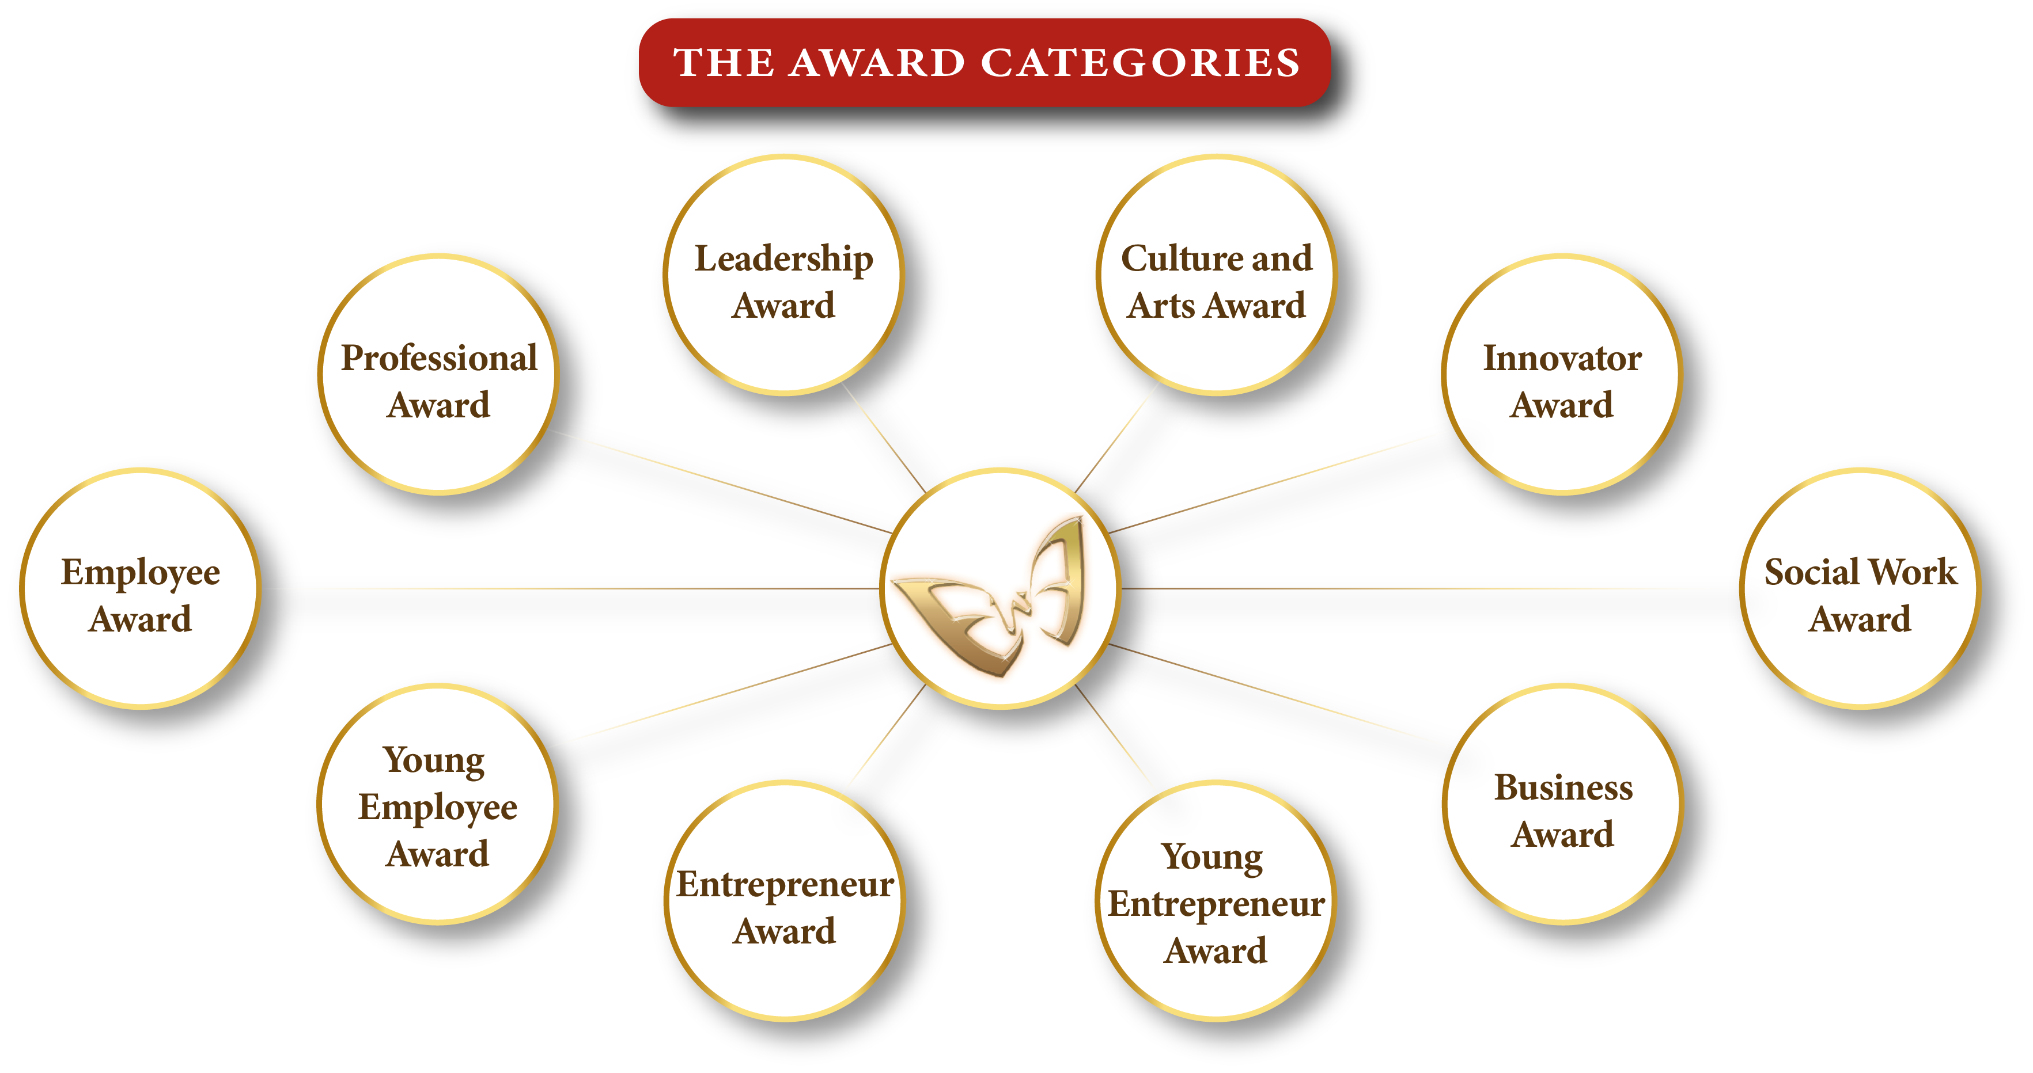
10
Kindly select one category only
Copyright Emirates Women Award (2003 – 2023) All Rights Reserved

Slide 3
Application Form
Applicant’s Name
Designation
Organization’s name
City/Emirate
Telephone
Mobile
Email
Years of experience
Submission date
I declare that the information given on this form is correct to the best of my knowledge

Slide 4
Attachments – Passport copy, residence visa, trade license (if applicable)
Passport Copy
Residence Visa
Trade Licence (if applicable).

Slide 5
The Innovator Award
Description
Criteria
Developed innovative solutions for successful positive change. (What)
Demonstrates risk taking and challenge the status quo, and willingness to experiment and learn from failure. (How)
Demonstrates business profitability, Level of Innovations, Effectiveness, Ability to replicate, and overall Impact. (Results)
Demonstrates social engagement through strong commitment to her community and personal involvement to civic endeavors.
This award recognizes a woman who has made significant innovative contributions, and successfully facilitated positive change to occur.
Eligibility
All women entrepreneurs, business owners, and employees.
The applicant must be a UAE national or hold a valid UAE residence permit.
The employment/business location must be in the UAE.

Slide 6
Developed innovative solutions for successful positive change (What).
(300 words maximum)

Slide 7
Evidence & supporting Documents – (Photos / Videos attachments Maximum)
Evidance Number 01
Evidance Number 03
Evidance Number 02
Evidance Number 04

Slide 8
Demonstrates risk taking and challenge the status quo, and willingness to experiment and learn
from failure. (How). (300 words maximum)
Demonstrates a process of self-development through self-actualization, skills development etc.

Slide 9
Evidence & supporting Documents – (Photos / Videos attachments Maximum)
Evidance Number 01
Evidance Number 03
Evidance Number 02
Evidance Number 04

Slide 10
Demonstrates business profitability, Level of Innovations, Effectiveness, Ability to replicate, and overall Impact. (Results). (300 words maximum)

Slide 11
Evidence & supporting Documents – (Photos / Videos attachments Maximum)
Evidance Number 01
Evidance Number 03
Evidance Number 02
Evidance Number 04

Slide 12
Demonstrates social engagement through strong commitment to her community and personal involvement to civic endeavors. (300 words maximum)

Slide 13
Evidence & supporting Documents – (Photos / Videos attachments Maximum)
Evidance Number 01
Evidance Number 03
Evidance Number 02
Evidance Number 04

Slide 14
To Submit your application, click here
For Submission and Sponsorship inquiries, contact:
Fatma Abdul Qader
+97156 545 7410
fatma@dqg.org
www.dqg.org
Copyright Emirates Women Award (2003 – 2023) All Rights Reserved

