Slide 1
EMIRATES WOMEN AWARD 19TH CYCLE
Young Employee Award
Submission Form 2023
Copyright Emirates Women Award (2003 – 2023) www.ewa.ae All Rights Reserved

Slide 2
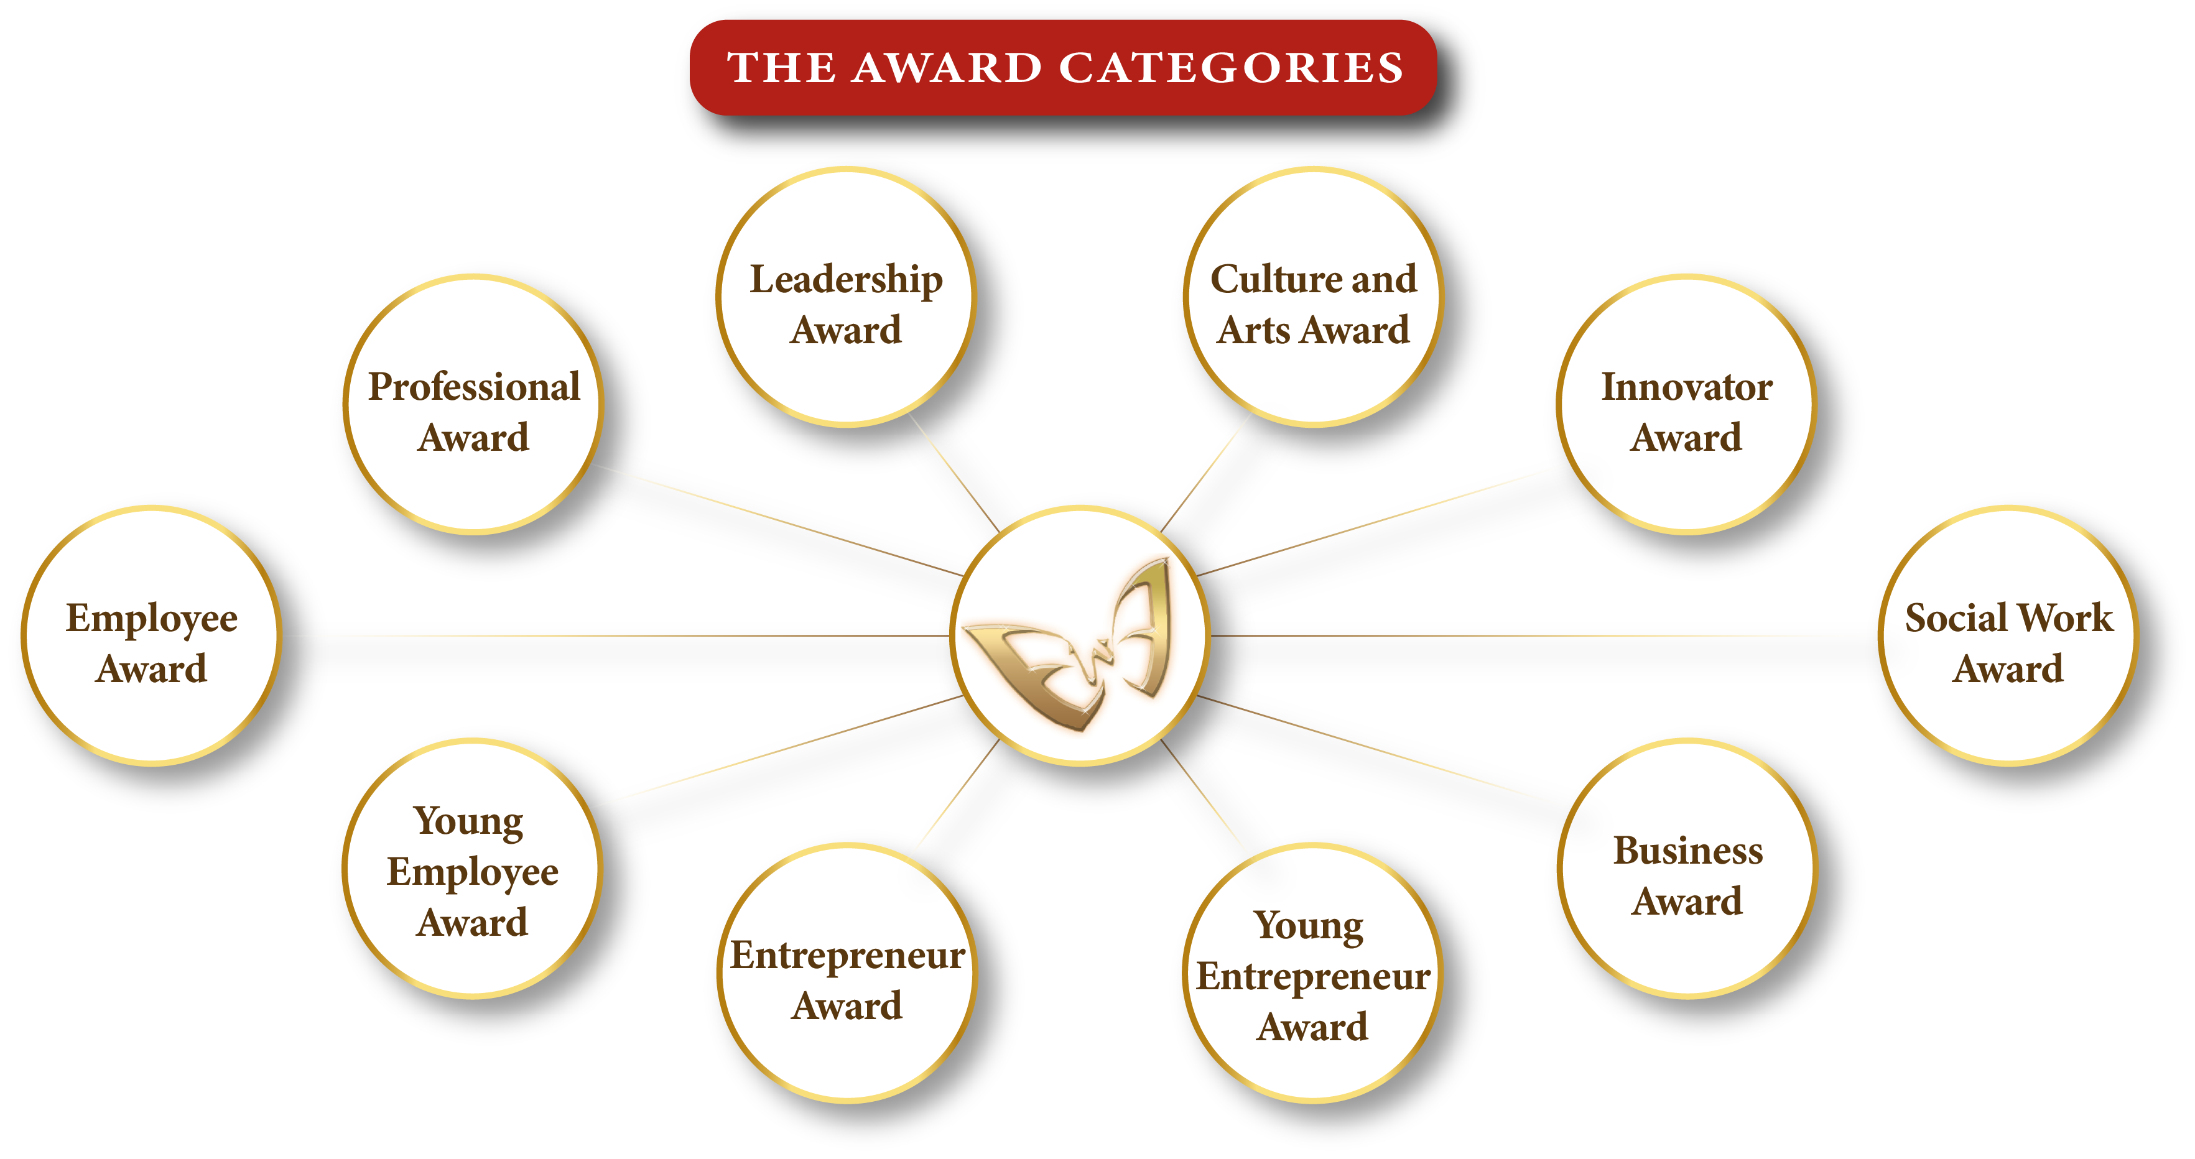
Kindly select one category only
Copyright Emirates Women Award (2003 – 2023) All Rights Reserved

Slide 3
Application Form
Applicant’s Name
Designation
Organization’s name
City/Emirate
Telephone
Mobile
Email
Years of experience
Submission date
I declare that the information given on this form is correct to the best of my knowledge

Slide 4
Attachments – Passport copy, residence visa, trade license (if applicable)
Passport Copy
Residence Visa
Trade Licence (if applicable).

Slide 5
Young Employee Award
Description
Criteria
This award recognizes an outstanding young woman employee who has made a major contribution to the growth and success of her company and serves as a role model for many young employees
Demonstrates professional & career achievements/performance
Demonstrates a process of self-development through self-actualization, skills development etc.
Demonstrates significant contribution to the organization's success/growth/improvement.
Demonstrates personal commitment and engagement in the community and social work.
Eligibility
All fulltime women employees in public or private companies with less than 35 years old.
The applicant must be a UAE national or hold a valid UAE residence permit.
The employment/business location must be in the UAE.

Slide 6
Demonstrates professional & career achievements/performance (300 words maximum)

Slide 7
Evidence & supporting Documents – (Photos / Videos attachments Maximum)
Evidance Number 01
Evidance Number 03
Evidance Number 02
Evidance Number 04

Slide 8
Demonstrates a process of self-development through self-actualization, skills development etc.
(300 words maximum)
Demonstrates a process of self-development through self-actualization, skills development etc.

Slide 9
Evidence & supporting Documents – (4 Photos / Videos attachments Maximum)
Evidance Number 01
Evidance Number 03
Evidance Number 02
Evidance Number 04

Slide 10
Demonstrates significant contribution to the organization's success/growth/improvement.
(300 words maximum)

Slide 11
Evidence & supporting Documents – (Photos / Videos attachments Maximum)
Evidance Number 01
Evidance Number 03
Evidance Number 02
Evidance Number 04

Slide 12
Demonstrates personal commitment and engagement in the community and social work.
(300 words maximum)

Slide 13
Evidence & supporting Documents – (Photos / Videos attachments Maximum)
Evidance Number 01
Evidance Number 03
Evidance Number 02
Evidance Number 04

Slide 14
To Submit your application, click here
For Submission and Sponsorship inquiries, contact:
Fatma Abdul Qader
+97156 545 7410
fatma@dqg.org
www.dqg.org
Copyright Emirates Women Award (2003 – 2023) All Rights Reserved

