Slide 1
EMIRATES WOMEN AWARD 19TH CYCLE
Young Entrepreneur Award
Submission Form 2023
Copyright Emirates Women Award (2003 – 2023) www.ewa.ae All Rights Reserved

Slide 2
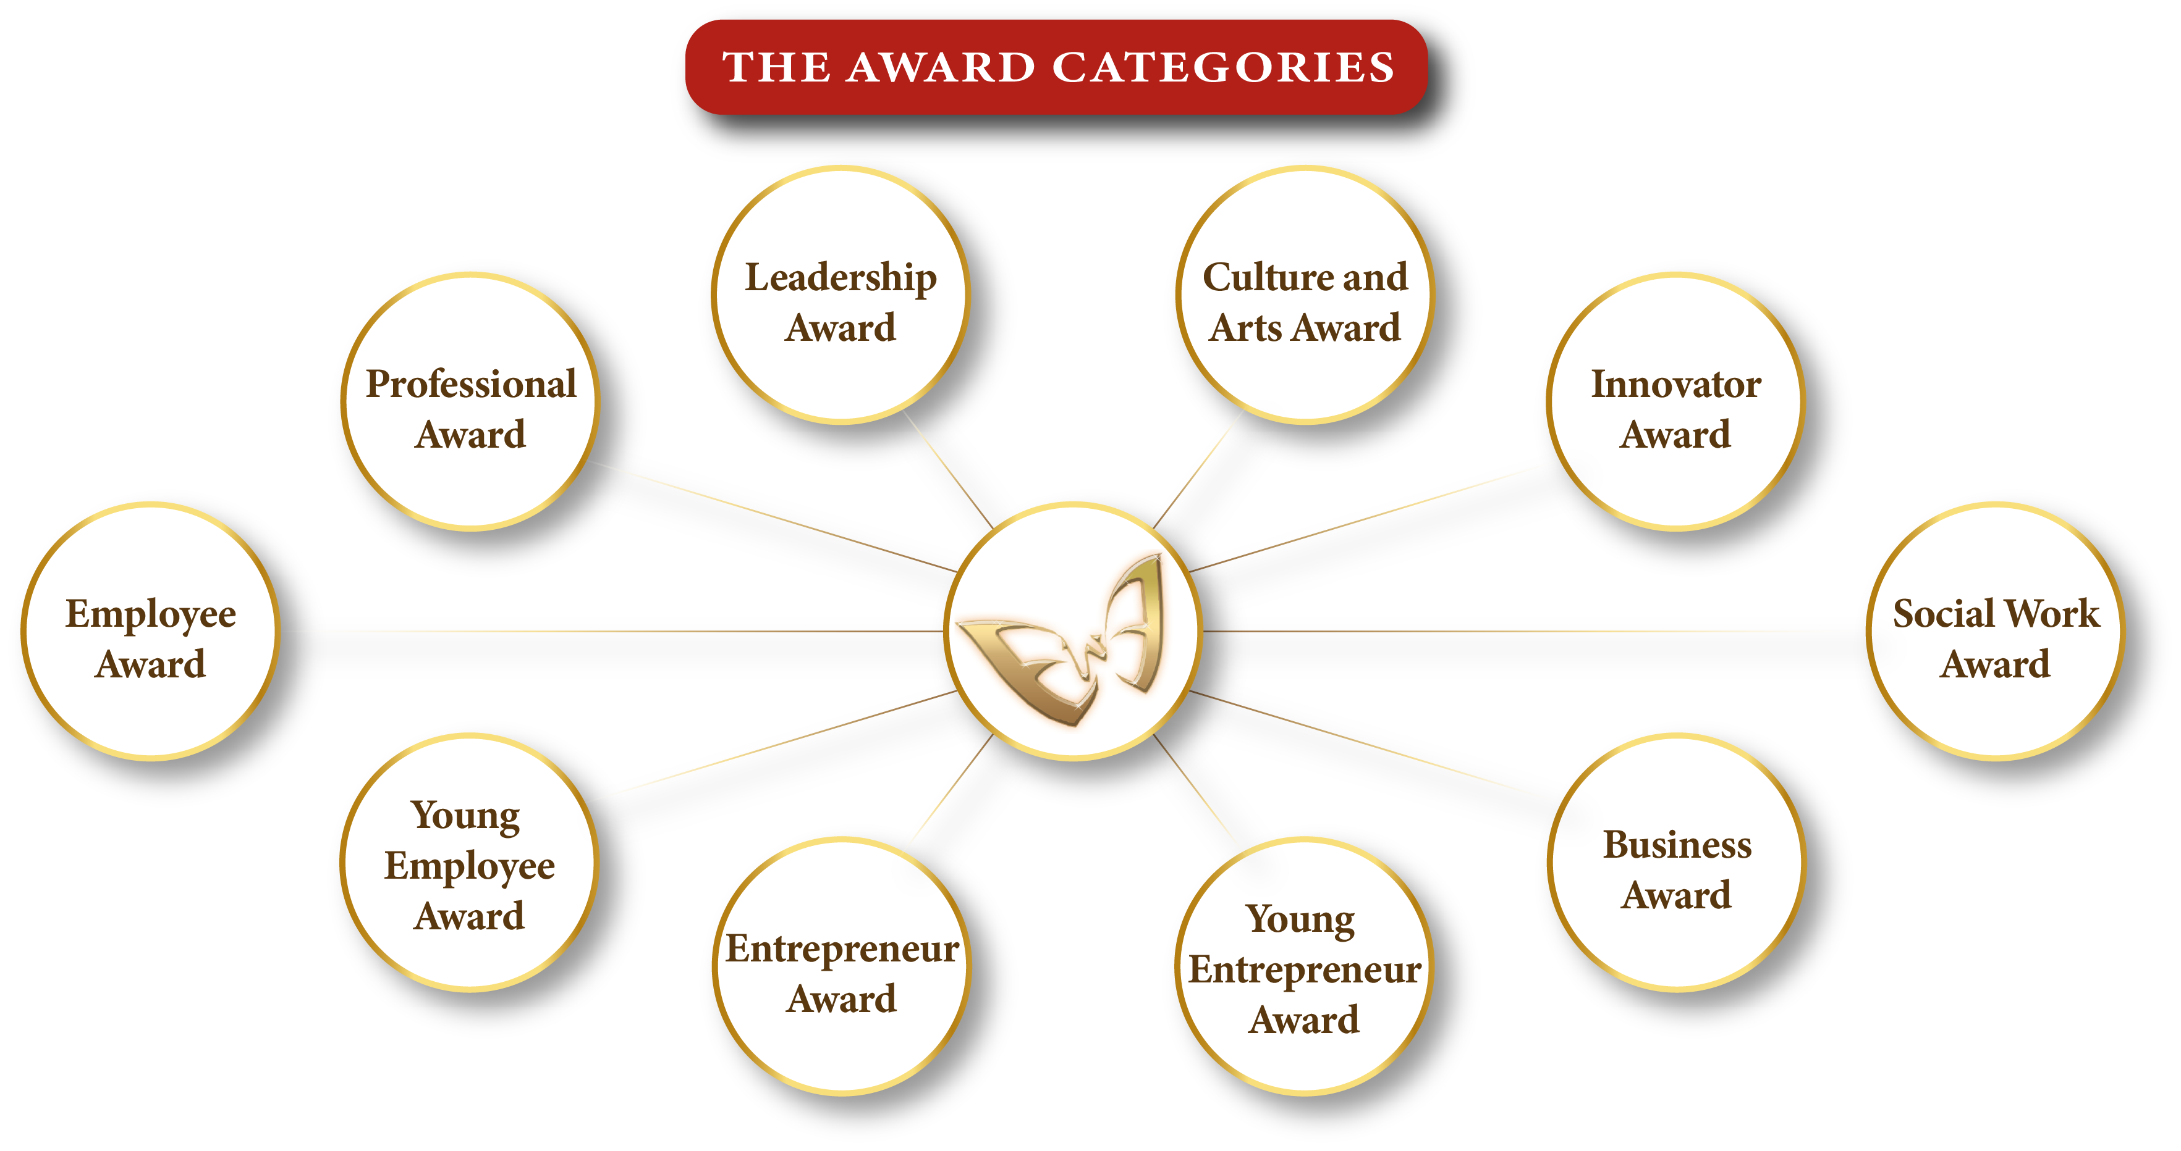
Kindly select one category only
Copyright Emirates Women Award (2003 – 2023) All Rights Reserved

Slide 3
Application Form
Applicant’s Name
Designation
Organization’s name
City/Emirate
Telephone
Mobile
Email
Years of experience
Submission date
I declare that the information given on this form is correct to the best of my knowledge

Slide 4
Attachments – Passport copy, residence visa, trade license (if applicable)
Passport Copy
Residence Visa
Trade Licence (if applicable).

Slide 5
Young Entrepreneur Award
Description
Criteria
This award honors a remarkable young woman under the age of 35 years who has started a successful business that addresses challenges or solutions in a novel and innovative way.
Demonstrates Innovation and business creativity by transforming traditional practices through innovative products, services, approaches etc.
Demonstrates business achievement and profitability.
Demonstrates entrepreneurial mindset through risk-taking, engaging others etc.
Demonstrates community engagement through charitable or leadership roles and/or creating new jobs.
Eligibility
All women entrepreneurs' founders of a business (18-35). Start-up less than five years.
The applicant must be a UAE national or hold a valid UAE residence permit.
The employment/business location must be in the UAE.

Slide 6
Demonstrates Innovation and business creativity by transforming traditional practices through innovative products, services, approaches etc. (300 words maximum)

Slide 7
Evidence & supporting Documents – (Photos / Videos attachments Maximum)
Evidance Number 01
Evidance Number 03
Evidance Number 02
Evidance Number 04

Slide 8
Demonstrates business achievement and profitability.
(300 words maximum)
Demonstrates a process of self-development through self-actualization, skills development etc.

Slide 9
Evidence & supporting Documents – (4 Photos / Videos attachments Maximum)
Evidance Number 01
Evidance Number 03
Evidance Number 02
Evidance Number 04

Slide 10
Demonstrates entrepreneurial mindset through risk-taking, engaging others etc.
(300 words maximum)

Slide 11
Evidence & supporting Documents – (Photos / Videos attachments Maximum)
Evidance Number 01
Evidance Number 03
Evidance Number 02
Evidance Number 04

Slide 12
Demonstrates community engagement through charitable or leadership roles and/or creating new
jobs. (300 words maximum)

Slide 13
Evidence & supporting Documents – (Photos / Videos attachments Maximum)
Evidance Number 01
Evidance Number 03
Evidance Number 02
Evidance Number 04

Slide 14
To Submit your application, click here
For Submission and Sponsorship inquiries, contact:
Fatma Abdul Qader
+97156 545 7410
fatma@dqg.org
www.dqg.org
Copyright Emirates Women Award (2003 – 2023) All Rights Reserved

