Slide 1
EMIRATES WOMEN AWARD 19TH CYCLE
Leadership Award
Submission Form 2023
Copyright Emirates Women Award (2003 – 2023) www.ewa.ae All Rights Reserved

Slide 2
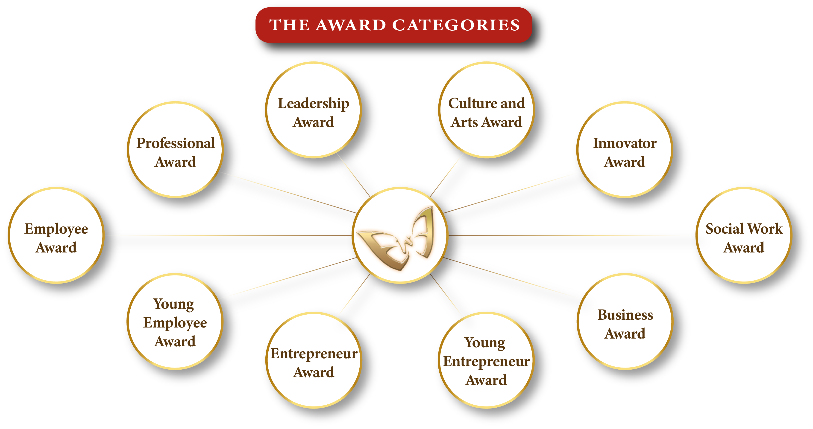
10
Kindly select one category only
Copyright Emirates Women Award (2003 – 2023) All Rights Reserved

Slide 3
Application Form
Applicant’s Name
Designation
Organization’s name
City/Emirate
Telephone
Mobile
Email
Years of experience
Submission date
I declare that the information given on this form is correct to the best of my knowledge

Slide 4
Attachments – Passport copy, residence visa, trade license (if applicable)
Passport Copy
Residence Visa
Trade Licence (if applicable).

Slide 5
EWA Leadership Award
Description
Criteria
This award recognizes a woman who is an inspiration to others and a role model to many. She is well-known for her leadership abilities. The awardee has a documented track record of accomplishment and growth in her field.
Mentoring and influencing others by sharing experience and investing in people.
Empowering and supporting people in achieving organizational and individual objectives
Demonstrates proven records of professional success *3 and accomplishment in her field.
Demonstrates personal leadership skills through Self-development, capacity to learn, balancing business and personal commitments.
Eligibility
All woman in a leading positions.
The applicant must be a UAE national or hold a valid UAE residence permit.
The employment/business location must be in the UAE.

Slide 6
Mentoring and influencing others by sharing experience and investing in people.
(300 words maximum)

Slide 7
Evidence & supporting Documents – (Photos / Videos attachments Maximum)
Evidance Number 01
Evidance Number 03
Evidance Number 02
Evidance Number 04

Slide 8
Empowering and supporting people in achieving organizational and individual objectives.
(300 words maximum)

Slide 9
Evidence & supporting Documents – (Photos / Videos attachments Maximum)
Evidance Number 01
Evidance Number 03
Evidance Number 02
Evidance Number 04

Slide 10
Demonstrates proven records of professional success and accomplishment in her field.
(300 words maximum)

Slide 11
Evidence & supporting Documents – (Photos / Videos attachments Maximum)
Evidance Number 01
Evidance Number 03
Evidance Number 02
Evidance Number 04

Slide 12
Demonstrates personal leadership skills through Self-development, capacity to learn, balancing
business and personal commitments. (300 words maximum)

Slide 13
Evidence & supporting Documents – (Photos / Videos attachments Maximum)
Evidance Number 01
Evidance Number 03
Evidance Number 02
Evidance Number 04

Slide 14
To Submit your application, click here
For Submission and Sponsorship inquiries, contact:
Fatma Abdul Qader
+97156 545 7410
fatma@dqg.org
www.dqg.org
Copyright Emirates Women Award (2003 – 2023) All Rights Reserved

